Slide 1
Assembly Language for x86 Processors 7th Edition
Kip R. Irvine
Chapter 11: MS-Windows Programming
Slide show prepared by the author
Revised by Zuoliu Ding at Fullerton College, 09/2014
(c) Pearson Education, 2015. All rights reserved. You may modify and copy this slide show for your personal use, or for use in the classroom, as long as this copyright statement, the author's name, and the title are not changed.

Slide 2
Chapter Overview
Win32 Console Programming
Writing a Graphical Windows Application
Dynamic Memory Allocation
x86 Memory Management
Irvine, Kip R. Assembly Language for x86 Processors 7/e, 2015.

Slide 3
Useful Questions
How do 32-bit programs handle text input-output?
How are colors handled in 32-bit console mode?
How does the Irvine32 link library work?
How are times and dates handled in MS-Windows?
How can I use MS-Windows functions to read and write data files?
Is it possible to write a graphical Windows application in assembly language?
How do Protected mode programs translate segments and offsets to physical addresses?
I’ve heard that virtual memory is good. But why is that so?
Irvine, Kip R. Assembly Language for x86 Processors 7/e, 2015.

Slide 4
Win32 Console Programming
Background Information
  Win32 Console Programs
  API and SDK
  Windows Data Types
  Standard Console Handles
Console Input
Console Output
Reading and Writing Files
Console Window Manipulation
Controlling the Cursor
Controlling the Text Color
Time and Date Functions
Irvine, Kip R. Assembly Language for x86 Processors 7/e, 2015.

Slide 5
Win32 Console Programs
Run in Protected mode
Emulate MS-DOS
Standard text-based input and output
Linker option : /SUBSYSTEM:CONSOLE
The console input buffer contains a queue of input records, each containing data about an input event.
A console screen buffer is a two-dimensional array of character and color data that affects the appearance of text in the console window.
Irvine, Kip R. Assembly Language for x86 Processors 7/e, 2015.

Slide 6
Classifying Console Functions
Text-oriented (high-level) console functions
  Read character streams from input buffer
  Write character streams to screen buffer
  Redirect input and output
Event-oriented (low-level) console functions
  Retrieve keyboard and mouse events
  Detect user interactions with the console window
  Control window size & position, text colors
Irvine, Kip R. Assembly Language for x86 Processors 7/e, 2015.

Slide 7
API and SDK
Microsoft Win32 Application Programming Interface
  API: a collection of types, constants, and functions that provide a way to directly manipulate objects through programming
Microsoft Platform Software Development Kit
  SDK: a collection of tools, libraries, sample code, and documentation that helps programmers create applications
  Platform: an operating system or a group of closely related operating systems
Irvine, Kip R. Assembly Language for x86 Processors 7/e, 2015.

Slide 8
Translating Windows Data Types
Windows Type(s) | MASM Type
BOOL | DWORD
LONG | SDWORD
COLORREF, HANDLE, LPARAM, LPCTSTR, LPTSTR, LPVOID, LRESULT, UINT, WNDPROC, WPARAM | DWORD
BSTR, LPCSTR, LPSTR | PTR BYTE
WORD | WORD
LPCRECT | PTR RECT
Irvine, Kip R. Assembly Language for x86 Processors 7/e, 2015.

Slide 9
Standard Console Handles
A handle is an unsigned 32-bit integer. The following MS-Windows constants are predefined to specify the type of handle requested:
STD_INPUT_HANDLE
  standard input
STD_OUTPUT_HANDLE
  standard output
STD_ERROR_HANDLE
  standard error output
See SmallWin.inc
Irvine, Kip R. Assembly Language for x86 Processors 7/e, 2015.

Slide 10
GetStdHandle
GetStdHandle returns a handle to a console stream
Specify the type of handle (see previous slide)
The handle is returned in EAX
Prototype:
Sample call:
GetStdHandle PROTO,
nStdHandle:DWORD ; handle type
INVOKE GetStdHandle, STD_OUTPUT_HANDLE
mov myHandle, eax
Irvine, Kip R. Assembly Language for x86 Processors 7/e, 2015.

Slide 11
Console Input
The ReadConsole function provides a convenient way to read text input and put it in a buffer.
Prototype:
ReadConsole PROTO,
handle:DWORD, ; input handle
pBuffer:PTR BYTE, ; pointer to buffer
maxBytes:DWORD, ; number of chars to read
pBytesRead:PTR DWORD, ; ptr to num bytes read
notUsed:DWORD ; (not used)
See ReadConsole.asm
Irvine, Kip R. Assembly Language for x86 Processors 7/e, 2015.

Slide 12
Single-Character Input
Here's how to input single characters:
Get a copy of the current console flags by calling GetConsoleMode. Save the flags in a variable.
Change the console flags by calling SetConsoleMode.
Input a character by calling ReadConsole.
Restore the previous values of the console flags by calling SetConsoleMode.
Irvine, Kip R. Assembly Language for x86 Processors 7/e, 2015.

Slide 13
Excerpts from ReadString (1 of 2)
From the ReadChar procedure in the Irvine32 library:
.data
consoleInHandle DWORD ?
saveFlags DWORD ? ; backup copy of flags
.code
; Get & save the current console input mode flags
INVOKE GetConsoleMode, consoleInHandle, ADDR saveFlags
; Clear all console flags
INVOKE SetConsoleMode, consoleInHandle, 0
Irvine, Kip R. Assembly Language for x86 Processors 7/e, 2015.

Slide 14
Excerpts from ReadString (2 of 2)
; Read a single character from input
INVOKE ReadConsole,
consoleInHandle, ; console input handle
ADDR buffer, ; pointer to buffer
1, ; max characters to read
ADDR bytesRead, ; return num bytes read
0 ; not used
; Restore the previous flags state
INVOKE SetConsoleMode, consoleInHandle, saveFlags
In Irvine32.asm, ReadChar calls ReadKey and ReadKey calls ReadConsoleInput
More about Input Mode flags, see SmallWin.inc or MSDN
Irvine, Kip R. Assembly Language for x86 Processors 6/e, 2010.

Slide 15
Test Result of TestReadKry
Key | AX | DX
F1 | 3B00 | 0070
Home | 4700 | 0024
ESC | 011B | 001B
A | 1E41 | 0041
a | 1E61 | 0041
^a | 1E61 | 0041
Check EBX for the Control Key State, DX: Virtual key
For Scan Code, see inside cover of the book or
  http://msdn.microsoft.com/en-us/library/aa299374%28v=VS.60%29.aspx
  http://flint.cs.yale.edu/cs422/doc/art-of-asm/pdf/APNDXC.PDF
For Virtual key Code, see VirtualKeys.inc or
  http://msdn.microsoft.com/en-us/library/ms927178.aspx
Added by Zuoliu Ding.

Slide 16
TestReadKry.asm
maintrk PROC
L1: mov eax,10 ; delay for msg processing
call Delay
call ReadKey ; wait for a keypress
jz L1
test ebx,CAPSLOCK_ON
jz L2
mWrite <"CapsLock is ON",0dh,0ah>
jmp L3
L2: mWrite <"CapsLock is OFF",0dh,0ah>
L3: exit
maintrk ENDP
Return AL: zero or ASCII code, AH: Scan code, DX: Virtual key, EBX: Control key state
Irvine, Kip R. Assembly Language for Intel-Based Computers, 5/e, 2007.

Slide 17
Keybd.asm
mainK PROC
INVOKE GetKeyState, VK_NUMLOCK
test al,1
.IF !Zero?
mWrite <"The NumLock key is ON",0dh,0ah>
.ENDIF
INVOKE GetKeyState, VK_LSHIFT
test al,80h
.IF !Zero?
mWrite <"The Left Shift key is DOWN",0dh,0ah>
.ENDIF
exit
mainK ENDP
for Toggle Key
Irvine, Kip R. Assembly Language for Intel-Based Computers, 5/e, 2007.

Slide 18
COORD and SMALL_RECT
The COORD structure specifies X and Y screen coordinates in character measurements, which default to 0-79 and 0-24.
The SMALL_RECT structure specifies a window’s location in character measurements.
COORD STRUCT
X WORD ?
Y WORD ?
COORD ENDS
SMALL_RECT STRUCT
Left WORD ?
Top WORD ?
Right WORD ?
Bottom WORD ?
SMALL_RECT ENDS
Irvine, Kip R. Assembly Language for x86 Processors 7/e, 2015.

Slide 19
WriteConsole
The WriteConsole function writes a string to the screen, using the console output handle. It acts upon standard ASCII control characters such as tab, carriage return, and line feed.
Prototype:
WriteConsole PROTO,
handle:DWORD, ; output handle
pBuffer:PTR BYTE, ; pointer to buffer
bufsize:DWORD, ; size of buffer
pCount:PTR DWORD, ; output count
lpReserved:DWORD ; (not used)
Example: Console1.asm
Irvine, Kip R. Assembly Language for x86 Processors 7/e, 2015.

Slide 20
In Console1.asm
mainc1 PROC
; Get the console output handle:
INVOKE GetStdHandle, STD_OUTPUT_HANDLE
mov consoleHandle,eax
mov ebx, messageSize
; Write a string to the console:
INVOKE WriteConsole,
consoleHandle, ; console output handle
ADDR message, ; string pointer
ebx, ; string length
ADDR bytesWritten, ; ret num bytes written
0 ; not used
INVOKE ExitProcess,0
mainc1 ENDP
Irvine, Kip R. Assembly Language for Intel-Based Computers, 5/e, 2007.

Slide 21
Console Window Manipulation
Screen buffer
Console window
Controlling the cursor
Controlling the text color
Irvine, Kip R. Assembly Language for x86 Processors 7/e, 2015.

Slide 22
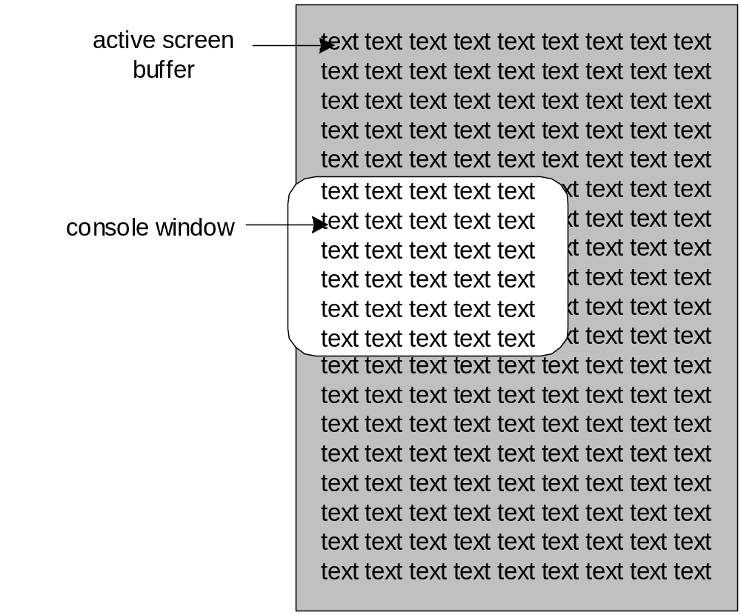
Screen Buffer and Console Window
The active screen buffer includes data displayed by the console window.
Irvine, Kip R. Assembly Language for x86 Processors 7/e, 2015.

Slide 23
SetConsoleTitle
SetConsoleTitle changes the console window's title. Pass it a null-terminated string:
.data
titleStr BYTE "Console title",0
.code
INVOKE SetConsoleTitle, ADDR titleStr
Irvine, Kip R. Assembly Language for x86 Processors 7/e, 2015.

Slide 24
GetConsoleScreenBufferInfo
GetConsoleScreenBufferInfo returns information about the current state of the console window. It has two parameters: a handle to the console screen, and a pointer to a structure that is filled in by the function:
.data
outHandle DWORD ?
consoleInfo CONSOLE_SCREEN_BUFFER_INFO <>
.code
INVOKE GetConsoleScreenBufferInfo,
outHandle,
ADDR consoleInfo
See usage: Clrscr, GetMaxXY, GetTextColor
Irvine, Kip R. Assembly Language for x86 Processors 7/e, 2015.

Slide 25
CONSOLE_SCREEN_BUFFER_INFO
CONSOLE_SCREEN_BUFFER_INFO STRUCT
dwSize COORD <>
dwCursorPos COORD <>
wAttributes WORD ?
srWindow SMALL_RECT <>
maxWinSize COORD <>
CONSOLE_SCREEN_BUFFER_INFO ENDS
dwSize - size of the screen buffer (char columns and rows)
dwCursorPos - cursor location
wAttributes - colors of characters in console buffer
srWindow - coords of console window relative to screen buffer
maxWinSize - maximum size of the console window
Irvine, Kip R. Assembly Language for x86 Processors 7/e, 2015.

Slide 26
SetConsoleWindowInfo
SetConsoleWindowInfo lets you set the size and position of the console window relative to its screen buffer.
Prototype:
SetConsoleWindowInfo PROTO,
nStdHandle:DWORD, ; screen buffer handle
bAbsolute:DWORD, ; coordinate type
pConsoleRect:PTR SMALL_RECT ; window rectangle
Irvine, Kip R. Assembly Language for x86 Processors 7/e, 2015.

Slide 27
SetConsoleScreenBufferSize
SetConsoleScreenBufferSize lets you set the screen buffer size to X columns by Y rows.
Prototype:
SetConsoleScreenBufferSize PROTO,
outHandle:DWORD, ; handle to screen buffer
dwSize:COORD ; new screen buffer size
Irvine, Kip R. Assembly Language for x86 Processors 7/e, 2015.

Slide 28
Controlling the Cursor
GetConsoleCursorInfo
  returns the size and visibility of the console cursor
SetConsoleCursorInfo
  sets the size and visibility of the cursor
SetConsoleCursorPosition
  sets the X, Y position of the cursor
Irvine, Kip R. Assembly Language for x86 Processors 7/e, 2015.

Slide 29
CONSOLE_CURSOR_INFO
Structure containing information about the console’s cursor size and visibility
  dwSize: Percentage 1 to 100 of the character cell
  bVisible: TRUE(1) or FALSE(0)
CONSOLE_CURSOR_INFO STRUCT
dwSize DWORD ?
bVisible DWORD ?
CONSOLE_CURSOR_INFO ENDS
100
50
25
Irvine, Kip R. Assembly Language for x86 Processors 7/e, 2015.

Slide 30
Example: Scroll.asm
INVOKE GetConsoleScreenBufferInfo, outHandle, offset consoleInfo
INVOKE SetConsoleWindowInfo, outHandle, TRUE, ADDR windowRect
INVOKE SetConsoleCursorPosition, outHandle, cursorPos
INVOKE SetConsoleScreenBufferSize, outHandle, ConsoleScreenBufferSize
INVOKE GetConsoleCursorInfo, outHandle, offset cursorInfo
INVOKE SetConsoleCursorInfo, outHandle, offset cursorInfo
Irvine, Kip R. Assembly Language for Intel-Based Computers, 5/e, 2007.

Slide 31
SetConsoleTextAttribute
Sets the foreground and background colors of all subsequent text written to the console.
Prototype:
SetConsoleTextAttribute PROTO,
outHandle:DWORD, ; console output handle
nColor:WORD ; color attribute
Irvine, Kip R. Assembly Language for x86 Processors 7/e, 2015.

Slide 32
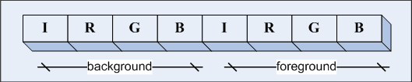
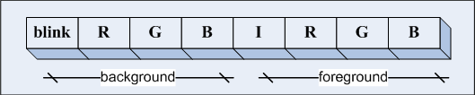
Chapter 16, BIOS-Level Programming
16.3.2 Controlling the Color - Attribute byte
  4 MSBs = background and 4 LSBs = foreground
  If blinking enabled, the highest controls the blinking
  MS-DOS default color: 7, 00000111
Zuoliu Ding: added from Chapter 16

Slide 33
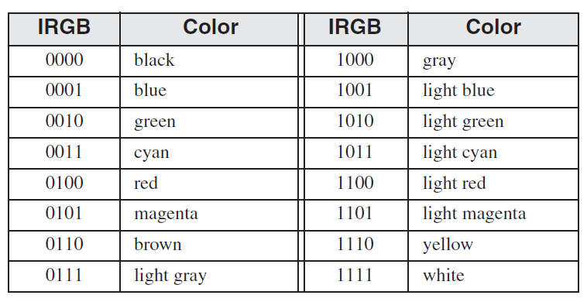
Chapter 16, BIOS-Level Programming
16.3.2 Controlling the Color
Table 16-4 Four-Bit Color Text Encoding:
Zuoliu Ding: added from Chapter 16

Slide 34
WriteConsoleOutputAttribute
Copies an array of attribute values to consecutive cells of the console screen buffer, beginning at a specified location.
Prototype:
WriteConsoleOutputAttribute PROTO,
outHandle:DWORD, ; output handle
pAttribute:PTR WORD, ; write attributes
nLength:DWORD, ; number of cells
xyCoord:COORD, ; first cell coordinates
lpCount:PTR DWORD ; number of cells written
Irvine, Kip R. Assembly Language for x86 Processors 7/e, 2015.

Slide 35
WriteConsoleOutputCharacter
The WriteConsoleOutputCharacter function copies an array of characters to consecutive cells of the console screen buffer, beginning at a specified location.
Prototype:
WriteConsoleOutputCharacter PROTO,
handleScreenBuf:DWORD, ; console output handle
pBuffer:PTR BYTE, ; pointer to buffer
bufsize:DWORD, ; size of buffer
xyPos:COORD, ; first cell coordinates
pCount:PTR DWORD ; output count
Irvine, Kip R. Assembly Language for x86 Processors 7/e, 2015.

Slide 36
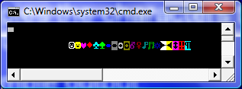
WriteColors Program
Creates an array of characters and an array of attributes, one for each character
Copies the attributes to the screen buffer
Copies the characters to the same screen buffer cells as the attributes
Sample output: (starts in row 2, column 10)
View the source code
Irvine, Kip R. Assembly Language for x86 Processors 7/e, 2015.

Slide 37
File Manipulation
Win32 API Functions that create, read, and write to files:
  CreateFile
  ReadFile
  WriteFile
  SetFilePointer
Irvine, Kip R. Assembly Language for x86 Processors 7/e, 2015.

Slide 38
CreateFile
CreateFile either creates a new file or opens an existing file. If successful, it returns a handle to the open file; otherwise, it returns a special constant named INVALID_HANDLE_VALUE.
Prototype:
CreateFile PROTO,
pFilename:PTR BYTE, ; ptr to filename
desiredAccess:DWORD, ; access mode
shareMode:DWORD, ; share mode
lpSecurity:DWORD, ; ptr to security attribs
creationDisposition:DWORD, ; file creation options
flagsAndAttributes:DWORD, ; file attributes
htemplate:DWORD ; handle to template file
Irvine, Kip R. Assembly Language for x86 Processors 7/e, 2015.

Slide 39
CreateFile Examples (1 of 3)
Opens an existing file for reading:
INVOKE CreateFile,
ADDR filename, ; ptr to filename
GENERIC_READ, ; access mode
DO_NOT_SHARE, ; share mode
NULL, ; ptr to security attributes
OPEN_EXISTING, ; file creation options
FILE_ATTRIBUTE_NORMAL, ; file attributes
0 ; handle to template file
Irvine, Kip R. Assembly Language for x86 Processors 7/e, 2015.

Slide 40
CreateFile Examples (2 of 3)
Opens an existing file for writing:
INVOKE CreateFile,
ADDR filename,
GENERIC_WRITE, ; access mode
DO_NOT_SHARE,
NULL,
OPEN_EXISTING,
FILE_ATTRIBUTE_NORMAL,
0
Irvine, Kip R. Assembly Language for x86 Processors 7/e, 2015.

Slide 41
CreateFile Examples (3 of 3)
Creates a new file with normal attributes, erasing any existing file by the same name:
INVOKE CreateFile,
ADDR filename,
GENERIC_WRITE,
DO_NOT_SHARE,
NULL,
CREATE_ALWAYS, ; overwrite existing file
FILE_ATTRIBUTE_NORMAL,
0
Irvine, Kip R. Assembly Language for x86 Processors 7/e, 2015.

Slide 42
ReadFile
ReadFile reads text from an input file
Prototype:
ReadFile PROTO,
handle:DWORD, ; handle to file
pBuffer:PTR BYTE, ; ptr to buffer
nBufsize:DWORD, ; num bytes to read
pBytesRead:PTR DWORD, ; bytes actually read
pOverlapped:PTR DWORD ; ptr to asynch info
Irvine, Kip R. Assembly Language for x86 Processors 7/e, 2015.

Slide 43
WriteFile
WriteFile writes data to a file, using an output handle. The handle can be the screen buffer handle, or it can be one assigned to a text file.
Prototype:
WriteFile PROTO,
fileHandle:DWORD, ; output handle
pBuffer:PTR BYTE, ; pointer to buffer
nBufsize:DWORD, ; size of buffer
pBytesWritten:PTR DWORD, ; num bytes written
pOverlapped:PTR DWORD ; ptr to asynch info
Irvine, Kip R. Assembly Language for x86 Processors 7/e, 2015.

Slide 44
SetFilePointer
SetFilePointer moves the position pointer of an open file. You can use it to append data to a file, and to perform random-access record processing:
SetFilePointer PROTO,
handle:DWORD, ; file handle
nDistanceLo:SDWORD, ; bytes to move pointer
pDistanceHi:PTR SDWORD, ; ptr to bytes to move
moveMethod:DWORD ; starting point
; Move to end of file:
INVOKE SetFilePointer,
fileHandle,0,0,FILE_END
Example:
Irvine, Kip R. Assembly Language for x86 Processors 7/e, 2015.

Slide 45
CloseHandle
You must call CloseHandle when reading or writing is done
CloseHandle PROTO,
handle:HANDLE, ; file handle
Added by Zuoliu Ding

Slide 46
Error Checking
Most I/O functions return zero if they fall
More details from GetLastError and FormatMessage
  Irvine32 has a wrapper called WriteWindowsMsg
call GetLastError ; Get the error message ID
mov messageId,eax
; Get corresponding message string
INVOKE FormatMessage, FORMAT_MESSAGE_ALLOCATE_BUFFER + FORMAT_MESSAGE_FROM_SYSTEM,
NULL, messageID, NULL,
ADDR pErrorMsg, NULL, NULL
mov edx, pErrorMsg
call WriteString ; Display the error message
INVOKE LocalFree, pErrorMsg ; Free the error string
Added by Zuoliu Ding

Slide 47
File I/O Programming
Irvine32 wrappers:
CreateOutputFile, OpenInputFile,
ReadFromFile, WriteToFile, CloseFile,
WriteWindowsMsg
Examples using above procedures:
CreateFile.asm, Self error check
AppendFile.asm, Demo: Windows Error Handling
ReadFile.asm, WriteWindowsMsg
Call WriteWindowsMsg to show error messages
Added by Zuoliu Ding

Slide 48
Time and Date Functions
GetLocalTime, SetLocalTime
GetTickCount, Sleep
GetDateTime
SYSTEMTIME Structure
Creating a Stopwatch Timer
Irvine, Kip R. Assembly Language for x86 Processors 7/e, 2015.

Slide 49
GetLocalTime, SetLocalTime
GetLocalTime returns the date and current time of day, according to the system clock.
SetLocalTime sets the system’s local date and time.
GetLocalTime PROTO,
pSystemTime:PTR SYSTEMTIME
SetLocalTime PROTO,
pSystemTime:PTR SYSTEMTIME
Irvine, Kip R. Assembly Language for x86 Processors 7/e, 2015.

Slide 50
SYSTEMTIME Structure
SYSTEMTIME is used by date and time-related Windows API functions:
SYSTEMTIME STRUCT
wYear WORD ? ; year (4 digits)
wMonth WORD ? ; month (1-12)
wDayOfWeek WORD ? ; day of week (0-6)
wDay WORD ? ; day (1-31)
wHour WORD ? ; hours (0-23)
wMinute WORD ? ; minutes (0-59)
wSecond WORD ? ; seconds (0-59)
wMilliseconds WORD ? ; milliseconds (0-999)
SYSTEMTIME ENDS
Irvine, Kip R. Assembly Language for x86 Processors 6/e, 2010.

Slide 51
GetTickCount, Sleep
GetTickCount function returns the number of milliseconds that have elapsed since the system was started.
Return in EAX, maximum 49.7 days. (Timer.asm)
Sleep pauses the current program for a specified number of milliseconds.
Suspend the current thread without CPU
GetTickCount PROTO ; return value in EAX
Sleep PROTO,
dwMilliseconds:DWORD
Irvine, Kip R. Assembly Language for x86 Processors, Modified by Zuoliu Ding

Slide 52
Creating a Stopwatch Timer
The Timer.asm program demonstrates a simple stopwatch timer
It has two important functions:
  TimerStart - receives a pointer to a doubleword, into which it saves the current time
  TimerStop - receives a pointer to the same doubleword, and returns the difference (in milliseconds) between the current time and the previously recorded time
Calls Win32 GetTickCount
View the source code
How about Irvine32 GetMseconds?
Irvine, Kip R. Assembly Language for x86 Processors 7/e, 2015.

Slide 53
GetDateTime
The GetDateTime procedure in the Irvine32 library calculates the number of 100-nanosecond time intervals that have elapsed since January 1, 1601. Pass it a pointer to an empty 64-bit FILETIME structure, which is then filled in by the procedure:
GetDateTime PROC,
pStartTime:PTR QWORD
FILETIME STRUCT
loDateTime DWORD ?
hiDateTime DWORD ?
FILETIME ENDS
Irvine, Kip R. Assembly Language for x86 Processors 7/e, 2015.

Slide 54
How to Get File Time
The GetFileTime procedure get three pointers to 64-bit FILETIME structure back as date/time stamps of a file:
GetFileTime PROTO,
hFile:HANDLE, pCreationTime: PTR FILETIME, pLastAccessTime:PTR FILETIME, pLastWriteTime: PTR FILETIME
FILETIME STRUCT
loDateTime DWORD ?
hiDateTime DWORD ?
FILETIME ENDS
Convert FILETIME to SYSTEMTIME:
FileTimeToSystemTime PROTO, lpFileTime: PTR FILETIME, lpSystemTime: PTR SYSTEMTIME
Zuoliu Ding: This slide is added for the file time programming exercise

Slide 55
64-Bit Windows API
Input and output handles are 64 bits
Before calling a system function, reserve at least 32 bytes of shadow space by subtracting from the stack pointer (RSP).
Restore RSP after the system call
Pass integers in 64-bit registers
First four arguments should be placed in RCX, RDX, R8, and R9 registers
64-bit integer values are returned in RAX
Irvine, Kip R. Assembly Language for x86 Processors 7/e, 2015.

Slide 56
Example: Calling GetStdHandle
.data
STD_OUTPUT_HANDLE EQU -11
consoleOutHandle QWORD ?
.code
sub rsp,40 ; reserve shadow space & align RSP
mov rcx,STD_OUTPUT_HANDLE
call GetStdHandle
mov consoleOutHandle,rax
add rsp,40
Irvine, Kip R. Assembly Language for x86 Processors 7/e, 2015.

Slide 57
Example: Calling WriteConsole
sub rsp, 5 * 8 ; space for 5 parameters
movr cx,rdx
call Str_length ; returns length of string in EAX
mov rcx,consoleOutHandle
mov rdx,rdx ; string pointer
mov r8, rax ; length of string
lea r9,bytesWritten
mov qword ptr [rsp + 4 * SIZEOF QWORD],0 ; (always zero)
call WriteConsoleA
Irvine, Kip R. Assembly Language for x86 Processors 7/e, 2015.

Slide 58
What's Next
Win32 Console Programming
Writing a Graphical Windows Application
Dynamic Memory Allocation
x86 Memory Management
Irvine, Kip R. Assembly Language for x86 Processors 7/e, 2015.

Slide 59
Writing a Graphical Windows Application
Required Files
POINT, RECT Structures
MSGStruct, WNDCLASS Structures
MessageBox Function
WinMain, WinProc Procedures
ErrorHandler Procedure
Message Loop & Processing Messages
Program Listing
Irvine, Kip R. Assembly Language for x86 Processors 7/e, 2015.

Slide 60
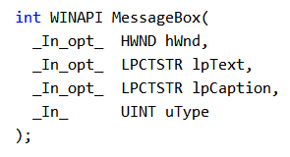
MessageBox Function
Displays text in a box that pops up and waits for the user to click on a button:
MessageBox PROTO,
hWnd:DWORD,
pText:PTR BYTE,
pCaption:PTR BYTE,
style:DWORD
hWnd is a handle to the current window. pText points to a null-terminated string that will appear inside the box. pCaption points to a null-terminated string that will appear in the box’s caption bar. style is an integer that describes both the dialog box’s icon (optional) and the buttons (required).
Irvine, Kip R. Assembly Language for x86 Processors 6/e, 2010.

Slide 61
MessageBox Example
Displays a message box that shows a question, including an OK button and a question-mark icon:
.data
hMainWnd DWORD ?
QuestionText BYTE "Register this program now?"
QuestionTitle BYTE "Trial Period Has Expired"
.code
INVOKE MessageBox,
hMainWnd,
ADDR QuestionText,
ADDR QuestionTitle,
MB_OK + MB_ICONQUESTION
Irvine, Kip R. Assembly Language for x86 Processors 6/e, 2010.

Slide 62
Displaying a Message Box
; Display a warning message.
INVOKE MessageBox, NULL, ADDR warningMsg,
ADDR captionW,
MB_OK + MB_ICONEXCLAMATION
; Ask a question, evaluate the response.
INVOKE MessageBox, NULL, ADDR questionMsg,
ADDR captionQ, MB_YESNO + MB_ICONQUESTION
cmp eax,IDYES ; YES button clicked?
jne L2 ; if not, skip
; More complex set of buttons. Confuse the user.
INVOKE MessageBox, NULL, ADDR infoMsg,
ADDR captionC,
MB_YESNOCANCEL + MB_ICONEXCLAMATION + MB_DEFBUTTON2
Irvine, Kip R. Assembly Language for Intel-Based Computers, 5/e, 2007.

Slide 63
Required Files
make32.bat - Batch file specifically for building this program
WinApp.asm - Program source code
GraphWin.inc - Include file containing structures, constants, and function prototypes used by the program
kernel32.lib - Same MS-Windows API library used earlier in this chapter
user32.lib - Additional MS-Windows API functions
When linking the program, use /SUBSYSTEM:WINDOWS Not /SUBSYSTEM:CONSOLE
Irvine, Kip R. Assembly Language for x86 Processors 7/e, 2015.

Slide 64
POINT and RECT Structures
POINT - X, Y screen coordinates
RECT - Holds the graphical coordinates of two opposing corners of a rectangle
POINT STRUCT
ptX DWORD ?
ptY DWORD ?
POINT ENDS
RECT STRUCT
left DWORD ?
top DWORD ?
right DWORD ?
bottom DWORD ?
RECT ENDS
Irvine, Kip R. Assembly Language for x86 Processors 7/e, 2015.

Slide 65
MSGStruct Structure
MSGStruct - holds data for MS-Windows messages (usually passed by the system and received by your application):
MSGStruct STRUCT
msgWnd DWORD ?
msgMessage DWORD ?
msgWparam DWORD ?
msgLparam DWORD ?
msgTime DWORD ?
msgPt POINT <>
MSGStruct ENDS
See Creating a Message Loop, MSDN
Irvine, Kip R. Assembly Language for x86 Processors 7/e, 2015.

Slide 66
WNDCLASS Structure (1 of 2)
Each window in a program belongs to a class, and each program defines a window class for its main window:
WNDCLASS STRUC
style DWORD ? ; window style options
lpfnWndProc DWORD ? ; WinProc function pointer
cbClsExtra DWORD ? ; shared memory
cbWndExtra DWORD ? ; number of extra bytes
hInstance DWORD ? ; handle to current program
hIcon DWORD ? ; handle to icon
hCursor DWORD ? ; handle to cursor
hbrBackground DWORD ? ; handle to background brush
lpszMenuName DWORD ? ; pointer to menu name
lpszClassName DWORD ? ; pointer to WinClass name
WNDCLASS ENDS
Irvine, Kip R. Assembly Language for x86 Processors 7/e, 2015.

Slide 67
WNDCLASS Structure (2 of 2)
style is a conglomerate of different style options, such as WS_CAPTION and WS_BORDER, that control the window’s appearance and behavior.
lpfnWndProc is a pointer to a function (in our program) that receives and processes event messages triggered by the user.
cbClsExtra refers to shared memory used by all windows belonging to the class. Can be null.
cbWndExtra specifies the number of extra bytes to allocate following the window instance.
hInstance holds a handle to the current program instance.
hIcon and hCursor hold handles to icon and cursor resources for the current program.
hbrBackground holds a background (color) brush.
lpszMenuName points to a menu string.
lpszClassName points to a null-terminated string containing the window’s class name.
Irvine, Kip R. Assembly Language for x86 Processors 7/e, 2015.

Slide 68
WinMain Procedure
Every Windows application needs a startup procedure, usually named WinMain, which is responsible for the following tasks:
Get a handle to the current program
Load the program’s icon and mouse cursor
Register the program’s main window class and identify the procedure that will process event messages for the window
Create the main window
Show and update the main window
Begin a loop that receives and dispatches messages
Irvine, Kip R. Assembly Language for x86 Processors 7/e, 2015.

Slide 69
WinProc Procedure
WinProc receives and processes all event messages relating to a window
  Some events are initiated by clicking and dragging the mouse, pressing keyboard keys, and so on
WinProc decodes each message, carries out application-oriented tasks related to the message
WinProc PROC,
hWnd:DWORD, ; handle to the window
localMsg:DWORD, ; message ID
wParam:DWORD, ; parameter 1 (varies)
lParam:DWORD ; parameter 2 (varies)
(Contents of wParam and lParam vary, depending on the message.)
Irvine, Kip R. Assembly Language for x86 Processors 7/e, 2015.

Slide 70
Sample WinProc Messages
In the example program from this chapter, the WinProc procedure handles three specific messages:
  WM_LBUTTONDOWN, generated when the user presses the left mouse button
  WM_CREATE, indicates that the main window was just created
  WM_CLOSE, indicates that the application’s main window is about to close
(many other messages are possible)
Irvine, Kip R. Assembly Language for x86 Processors 7/e, 2015.

Slide 71
ErrorHandler Procedure
The ErrorHandler procedure has several important tasks to perform:
  Call GetLastError to retrieve the system error number
  Call FormatMessage to retrieve the appropriate system-formatted error message string
  Call MessageBox to display a popup message box containing the error message string
  Call LocalFree to free the memory used by the error message string
(sample)
Irvine, Kip R. Assembly Language for x86 Processors 7/e, 2015.

Slide 72
ErrorHandler Sample
INVOKE GetLastError ; Returns message ID in EAX
mov messageID,eax
; Get the corresponding message string.
INVOKE FormatMessage, FORMAT_MESSAGE_ALLOCATE_BUFFER + \
FORMAT_MESSAGE_FROM_SYSTEM, NULL, messageID, NULL,
ADDR pErrorMsg, NULL, NULL
; Display the error message.
INVOKE MessageBox, NULL, pErrorMsg, ADDR ErrorTitle,
MB_ICONERROR + MB_OK
; Free the error message string.
INVOKE LocalFree, pErrorMsg
Irvine, Kip R. Assembly Language for x86 Processors 7/e, 2015.

Slide 73
Message Loop
In WinMain, the message loop receives and dispatches (relays) messages:
Message_Loop:
; Get next message from the queue.
INVOKE GetMessage, ADDR msg, NULL,NULL,NULL
; Quit if no more messages.
.IF eax == 0
jmp Exit_Program
.ENDIF
; Relay the message to the program's WinProc.
INVOKE DispatchMessage, ADDR msg
jmp Message_Loop
Irvine, Kip R. Assembly Language for x86 Processors 7/e, 2015.

Slide 74
Processing Messages
WinProc receives each message and decides what to do with it:
WinProc PROC, hWnd:DWORD, localMsg:DWORD,
wParam:DWORD, lParam:DWORD
mov eax, localMsg
.IF eax == WM_LBUTTONDOWN ; mouse button?
INVOKE MessageBox, hWnd, ADDR PopupText,
ADDR PopupTitle, MB_OK
jmp WinProcExit
.ELSEIF eax == WM_CREATE ; create window?
INVOKE MessageBox, hWnd, ADDR AppLoadMsgText,
ADDR AppLoadMsgTitle, MB_OK
jmp WinProcExit
(etc.)
WinProc PROC, hWnd:DWORD, localMsg:DWORD,
wParam:DWORD, lParam:DWORD
mov eax, localMsg
.IF eax == WM_LBUTTONDOWN ; mouse button?
mov eax, lParam
mov pt.X, ax
shr eax, 16
mov pt.Y, ax
... ...
INVOKE MessageBox, hWnd, ADDR PopupText,
ADDR PopupTitle, MB_OK
jmp WinProcExit
(etc.)
Irvine, Kip R. Assembly Language for x86 Processors 6/e, 2010.

Slide 75
Program Listing
View the program listing (WinApp.asm)
Run the program
Demo: WM_SIZE and Error lookup (zd)
When linking the program, remember to replace
/SUBSYSTEM:CONSOLE
with: /SUBSYSTEM:WINDOWS
Irvine, Kip R. Assembly Language for x86 Processors 7/e, 2015.

Slide 76
What's Next
Win32 Console Programming
Writing a Graphical Windows Application
Dynamic Memory Allocation
x86 Memory Management
Irvine, Kip R. Assembly Language for x86 Processors 7/e, 2015.

Slide 77
Dynamic Memory Allocation
Reserving memory at runtime for objects
  aka heap allocation
  standard in high-level languages (C++, Java)
Heap manager
  allocates large blocks of memory
  maintains free list of pointers to smaller blocks
  manages requests by programs for storage
Irvine, Kip R. Assembly Language for x86 Processors 7/e, 2015.

Slide 78
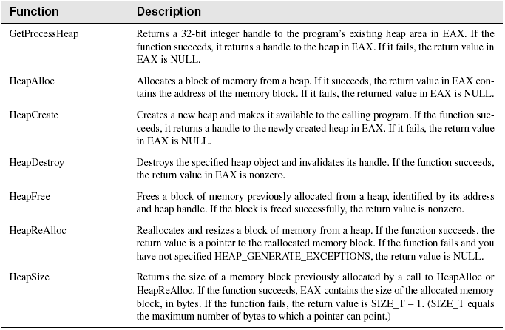
Windows Heap-Related Functions
Irvine, Kip R. Assembly Language for x86 Processors 7/e, 2015.

Slide 79
Sample Code
Get a handle to the program's existing heap
or Create a handle to a private heap.
.data
hHeap HANDLE ?
.code
INVOKE GetProcessHeap
.IF eax == NULL ; cannot get handle
jmp quit
.ELSE
mov hHeap,eax ; handle is OK
.ENDIF
INVOKE HeapCreate, 0, HEAP_START, HEAP_MAX
Irvine, Kip R. Assembly Language for x86 Processors 6/e, 2010.

Slide 80
Sample Code
Allocate block of memory from existing heap:
.data
hHeap HANDLE ? ; heap handle
pArray DWORD ? ; pointer to array
.code
INVOKE HeapAlloc, hHeap, HEAP_ZERO_MEMORY, 1000
.IF eax == NULL
mWrite "HeapAlloc failed"
jmp quit
.ELSE
mov pArray,eax
.ENDIF
Irvine, Kip R. Assembly Language for x86 Processors 7/e, 2015.

Slide 81
Sample Code
Free a block of memory previously created by calling HeapAlloc:
.data
hHeap HANDLE ? ; heap handle
pArray DWORD ? ; pointer to array
.code
INVOKE HeapFree,
hHeap, ; handle to heap
0, ; flags
pArray ; pointer to array
Irvine, Kip R. Assembly Language for x86 Processors 7/e, 2015.

Slide 82
Sample Programs
Heaptest1.asm
  Allocates and fills an array of bytes
Heaptest2.asm
  Creates a heap and allocates multiple memory blocks until no more memory is available
Irvine, Kip R. Assembly Language for x86 Processors 7/e, 2015.

Slide 83
What's Next
Win32 Console Programming
Writing a Graphical Windows Application
Dynamic Memory Allocation
x86 Memory Management
Irvine, Kip R. Assembly Language for x86 Processors 7/e, 2015.

Slide 84
x86 Memory Management
Reviewing Some Terms
New Terms
Translating Addresses
Converting Logical to Linear Address
Page Translation
Irvine, Kip R. Assembly Language for x86 Processors 7/e, 2015.

Slide 85
Reviewing Some Terms
Multitasking permits multiple programs (or tasks) to run at the same time. The processor divides up its time between all of the running programs.
Segments are variable-sized areas of memory used by a program containing either code or data.
Segmentation provides a way to isolate memory segments from each other. This permits multiple programs to run simultaneously without interfering with each other.
A segment descriptor is a 64-bit value that identifies and describes a single memory segment: it contains information about the segment’s base address, access rights, size limit, type, and usage.
Irvine, Kip R. Assembly Language for x86 Processors 7/e, 2015.

Slide 86
New Terms
A segment selector is a 16-bit value stored in a segment register (CS, DS, SS, ES, FS, or GS).
  provides an indirect reference to a memory segment
A logical address is a combination of a segment selector and a 32-bit offset.
Irvine, Kip R. Assembly Language for x86 Processors 7/e, 2015.

Slide 87
Translating Addresses
The x86 processor uses a one- or two-step process to convert a variable's logical address into a unique memory location.
The first step combines a segment value with a variable’s offset to create a linear address.
The second optional step, called page translation, converts a linear address to a physical address.
Irvine, Kip R. Assembly Language for x86 Processors 7/e, 2015.

Slide 88
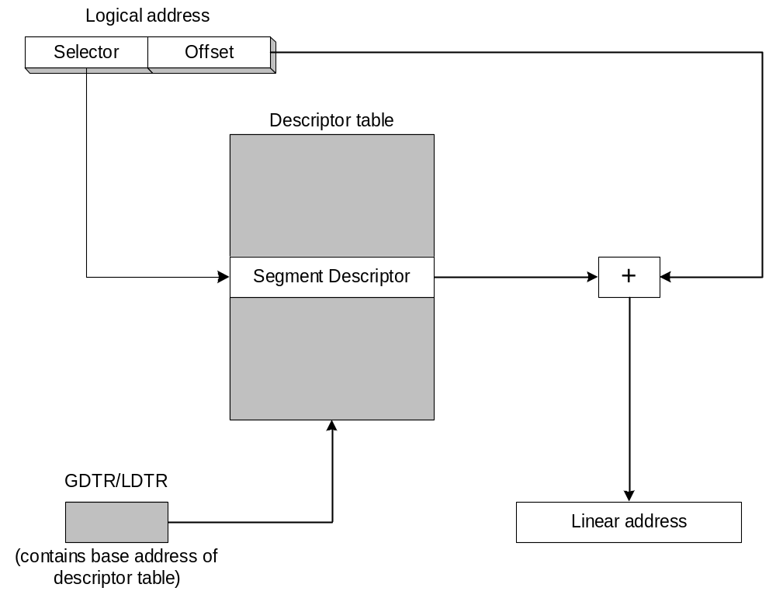
Converting Logical to Linear Address
The segment selector points to a segment descriptor, which contains the base address of a memory segment. The 32-bit offset from the logical address is added to the segment’s base address, generating a 32-bit linear address.
Irvine, Kip R. Assembly Language for x86 Processors 7/e, 2015.

Slide 89
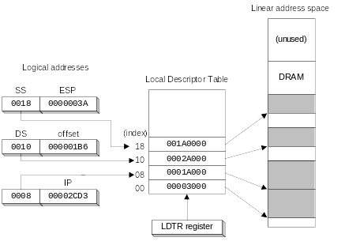
Indexing into a Descriptor Table
Each segment descriptor indexes into the program's local descriptor table (LDT). Each table entry is mapped to a linear address:
CS
Irvine, Kip R. Assembly Language for x86 Processors 6/e, 2010.

Slide 90
What is Segment Descriptor ?
Base address
Privilege level
Segment type
Segment present flag
Granularity flag
Segment limit
Irvine, Kip R. Assembly Language for Intel-Based Computers, 5/e, 2007.

Slide 91
Paging (1 of 2)
Paging makes it possible for a computer to run a combination of programs that would not otherwise fit into memory.
Only part of a program must be kept in memory, while the remaining parts are kept on disk.
The memory used by the program is divided into small units called pages.
As the program runs, the processor selectively unloads inactive pages from memory and loads other pages that are immediately required.
Irvine, Kip R. Assembly Language for x86 Processors 7/e, 2015.

Slide 92
Paging (2 of 2)
OS maintains page directory and page tables
Page translation: CPU converts the linear address into a physical address
Page fault: occurs when a needed page is not in memory, and the CPU interrupts the program
OS copies the page into memory, program resumes execution
Irvine, Kip R. Assembly Language for x86 Processors 7/e, 2015.

Slide 93
Page Translation
A linear address is divided into a page directory field, page table field, and page frame offset. The CPU uses all three to calculate the physical address.
Irvine, Kip R. Assembly Language for x86 Processors 7/e, 2015.

Slide 94
Review Questions
1. Define the following terms:
a. Multitasking.
b. Segmentation.
2. Define the following terms:
a. Segment selector
b. Logical address
3. (True/False): A segment selector points to an entry in a segment descriptor table.
4. (True/False): A segment descriptor contains the base location of a segment.
5. (True/False): A segment selector is 32 bits.
6. (True/False): A segment descriptor does not contain segment size information.
7. Describe a linear address.
8. How does paging relate to linear memory?
Irvine, Kip R. Assembly Language for x86 Processors 7/e, 2015.

Slide 95
Summary
32-bit console programs
  read from the keyboard and write plain text to the console window using Win32 API functions
Important functions
  ReadConsole, WriteConsole, GetStdHandle, ReadFile, WriteFile, CreateFile, CloseHandle, SetFilePointer
Dynamic memory allocation
  HeapAlloc, HeapFree
x86 Memory management
  segment selectors, linear address, physical address
  segment descriptor tables
  paging, page directory, page tables, page translation
Irvine, Kip R. Assembly Language for x86 Processors 7/e, 2015.

Slide 96
The End
Irvine, Kip R. Assembly Language for x86 Processors 7/e, 2015.

